Slide 1
DRAFT AWP&B
Mid Day Meal Scheme in SIKKim:
2014-15
SIKKIM
ANNUAL WORK PLAN & BUDGET
2019-20
MID-DAY MEAL SCHEME

Slide 2
ADMINISTRATIVE HIERARCHY OF MDM SCHEME.
State Project Office (director)
District Project Office (jt. Director]
block Level (Asst. Director).
School Level (HoIs).

Slide 3
NUMBER OF INSTITUTIONs COVERED UNDER MDM
Category | GOVT. | MONAS | SANS | TOTAL
PRY | 401 | 87 | 10 | 498
UP-PRY | 363 | 01 | 06 | 370
TOTAL | 764 | 88 | 16 | 868

Slide 4
Kitchen cum Store
Year-wise details of sanctioned:-
Fin. Year | No. of units sanctioned | Central Assistance released [Rs. In lakh] | State Share | Remarks
2006-07 | 245 | 147.00 | 0
 | 555 | 333.00 | 155.00
2008-09 | 59 | 35.40 | 16.52
2013-14 | 77 | 168.94 | 16.90
2018-19 | 12 | 26.39 | 2.93
Total | 948 | 710.73 | 191.35 | All completed

Slide 5
Details of Kitchen Devices: till 2018-19
Fin. Year | Nos. of Units sanctioned | Central assistance released. [Rs. In lakh] |  | Remarks
2006-07 | 446 | 22.32 |  | Utilized
2007-08 | 336 | 16.80 |  | --do--
2011-12 | 97 | 4.85 |  | --do--
Total | 879 | 43.97 |  | --do--
Replacement
2012-13 | 332 | 16.60 | --do--
 | 111 | 5.55 | --do--
2013-14 | 336 | 16.80 | --do--
2018-19 | 540 | 27.00 | 4.85
Total | 1319 | 65.95 | 4.85

Slide 6
ENTITLEMENT OF COOKING COST, 2018-19
CATEGORY | CENTRAL Child/day | STATE [child/day] | TOTAL Child/day
PRIMARY | 3.91 | 0.44 | [4.35]
UPPER PRIMARY | 5.86 | 0.65 | [6.51]

Slide 7
Foodgrains allocation, lifted & Payment thereof: 2018-19
CATEGORY | ALLOCATION [in MTs] | LIFTED in MTS. [upto 3rd Qtr] | Payment to FCI [Rs. In lakh]
PRY | 702.23 | 702.23 | 21.07
UP-PRY | 896.31 | 896.31 | 26.89
TOTAL | 1598.54 | 1598.54 | 47.96

Slide 8
DISTRICT-WISE PERFORMANCE IN Primary. 2018-19
 | Primary |  |  | Performance Against enrolment 2017-18 [%] | Performance against PAB 2018-19 [%]
DISTT | PAB [approved] | Enrol [as on Sept. 18] | Diff [%] gain
EAST | 12961 | 13822 | 7 | 88 | 90%
WEST | 7539 | 8143 | 8 | 92 | 96%
NORTH | 2533 | 2576 | 2 | 94 | 96%
SOUTH | 8314 | 8892 | 7 | 91 | 99%
TOTAL | 31348 | 33433 | 7 | 90% | 94%

Slide 9
District-wise Performance in Up-Pry: 2018-19
 | Upper Pry |  |  | Performance in % against PAB 2017-18 | Performance during against PAB: 2018-19
Distt | PAB [Approved] | Enrol [as on Sept,18] | Diff [less]
EAST | 10962 | 9979 | 9 | 90 | 91%
WEST | 7083 | 6219 | 12 | 90 | 88%
NORTH | 1766 | 1593 | 10 | 91 | 90%
SOUTH | 6864 | 6426 | 60 | 92 | 94%
TOTAL | 26676 | 24217 | 9% | 90 | 91%

Slide 10
Details of Central and State share received during:- 2018-19
Particulars | Centre Share [Rs. In lakh.] | State Share [Rs. In lakh] | TOTAL [Rs. In lakh] | Exp. of CSS [Rs. In lakh] | Balance of CSS [as on march, 19] [Rs. In lakh]
Cost of food-grain | 47.96 | 00 | 47.96 | 47.96 | 00
Cooking cost | 625.09 | 63.26 | 688.35 | 572.71 | 52.38
HCCH | 170.19 | 18.81 | 189 | 169.29 | .090
Transportation Cost | 29.09 | 0 | 29.09 | 29.09 | 00
MME | 14.87 | 0 | 14.87 | 14.87 | 00
Total | 887.2 | 82.07 | 969.27 | 833.92 | 53.28

Slide 11
NEW INITIATIVES:-
Sensitizing of MDM scheme at every level.
Opening of Jt. MDM Bank Accounts for all schools.
Centralized payment of FCI.
Training of Cooks cum Helpers at district level by master cooks.
Training to MIS coordinators at districts level to enhance the output.

Slide 12
Best Practices:-
Many schools are growing organic vegetables from their school Nutrition Garden.
Schools in rural areas are serving organic vegetables in mid-day meal from the school’s nutrition garden.
Schools are developing Nutrition Garden in their school premises.
Eggs, Fruits & Meats are also being provided during mid-day meal in schools.
Frequent sensitization of hand wash by school teachers.
Multi-tap facilities in schools are being provided by local agencies.
Time to time interaction with students representative about the quality of meals.
Cooking agencies PTA/SMCs are actively involved in serving MDM in the schools.
Grievance Redressal Mechanism.
Involvement of mothers of children in supervision of cooking of mid-day meal.

Slide 13
State Contigency/Emergency Plan:
All officers, school heads, cooking agencies etc are being sensitized on safety measures viz:-
Disaster Management.
Combating fire incidents.
First Aid applications.
Immediate information.
School heads are directed to seek immediate help from Block level officers, Fire Deptt, Police Station, Panchayats, PTA with their respective Phone/Mob. No. provided.
Teaching & Non Teaching staff are sensitizing children on safety measures to deal any kinds of emergency situation.

Slide 14
Proposal for
2019-20

Slide 15
Proposal for 2018-19
No. of Enrolment:
Primary : 29,573
Upper Pry : 24,217
Total : 53,790
No. of Schools:
Primary : 498
Upper Pry : 370
Total : 868
No. of Cook cum Helpers:
Primary/Upper Pry : 1891
REQUIREMENTOF FOODGRAINS
674.27+828.22=1502.49MTs
Working Days : 228

Slide 16
Proposal for central assistant [2019-20] Recurring.
Components | PRY | Up-PRY | TOTAL
Foodgrains | 20.23 | 24.85 | 45.08
Cooking Cost | 263.64 | 323.56 | 587.20
HCCH | 107.46 | 62.73 | 170.19
Transportation | 12.27 | 15.07 | 27.34
MME | 10.90 | 11.51 | 22.41
Replacement of Kit. Dev | 336 units | 47.43 | 47.43
Nutrition Garden | 44 Units @ Rs.5000/- | 1.98 | 1.98
TOTAL | 414.50 | 487.13 | 901.63

Slide 17
PROBLEMS & ISSUES.
Honorarium of CCH needs to be increased from the present level of Rs. 1000/* to at least Rs.1500/-

Slide 18
GLIMPSES OF BEST PRACTICES IN SIKKIM [mid-day meal]

Slide 19
NUTRITION GARDEN

Slide 20
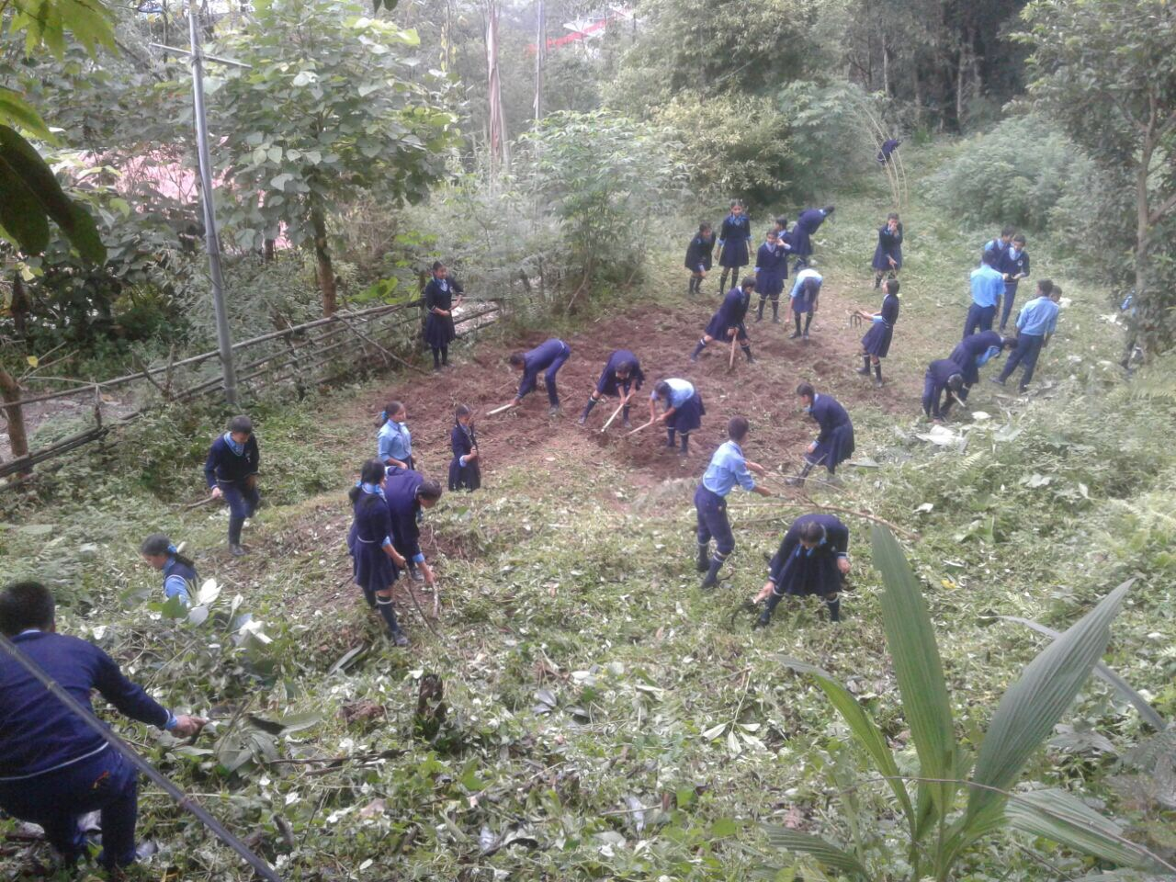
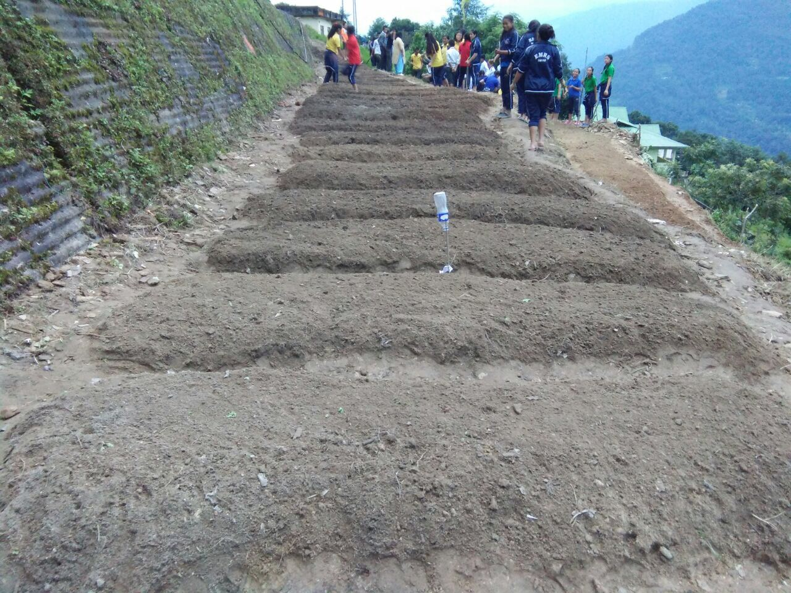
Preparing nursery bed for Organic saplings by students at schools.

Slide 23
STUDENTS WITH GARDENING TOOLS

Slide 24
Students watering tomatoes in poly house

Slide 26
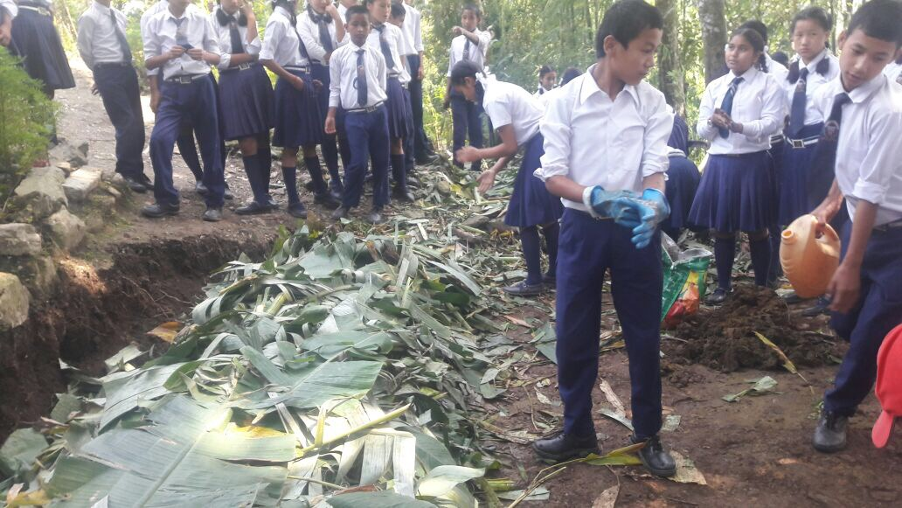
PREPARATION OF COMPOST PIT

Slide 27
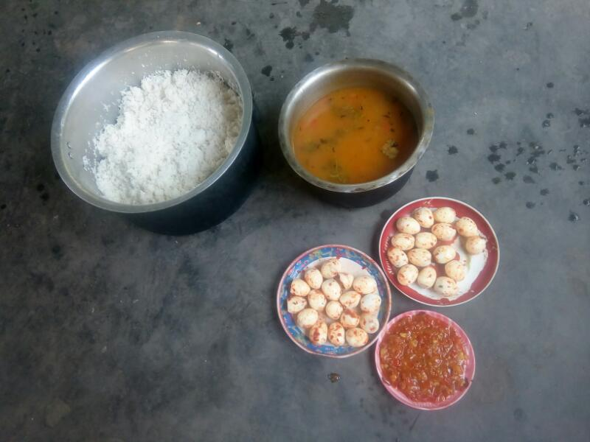
Serving eggs in MDM

Slide 28
MULTI TAP FACILITIES

Slide 29
Kitchen cum Dining sponsored by Local

Slide 30
Dining & kitchen constructed by local agencies.

Slide 32
MDM I/C checking weighing at FCI godown.
Area Counselor checking mdm at school

Slide 33
Training at District level
Stake holders
School Heads/MDM Tr.

Slide 34
TRANING OF CCH. AT DISTRICT LEVEL.

Slide 35
THANK YOU

